Slide 1
Data Centre Infrastructure
CT109-3-2 and Version VC1
Introduction and Overview

Slide 2
Lecturer information
Lecturer Name: Dr. K.C. Arun
Email: kchandran.arun@staffemail.apu.edu.my
Telephone Extension:

Slide 3
Pre-requisites for this module
None

Slide 4
Aims of this module
The purpose of Data Centre Infrastructure is to provide knowledge of the various elements within a data center, the various specialisms involved, and the associated best practices.
Data center infrastructure/design requires a multi-disciplinary solution, therefore this module is not intended to give students the ability to individually manage, control or optimize all aspects of a data center design or build but to provide them with the skills to work with assistance from experts in other disciplines to deliver an overall design and efficiency strategy

Slide 5
Course Learning outcomes, CLOs
At the end of this module, YOU should be able to:
1 Evaluate the options for Data Centre designs including the
types of data centers for different computing architectures
and business models (C5,PLO1).
2 Produce a design plan for a Data Centre with necessary
components for an organization based on a given scenario
(C3,PLO3).
3 Choose cooling and energy management systems that
promote sustainability and green computing in a data
centre (A3,PLO5).

Slide 6
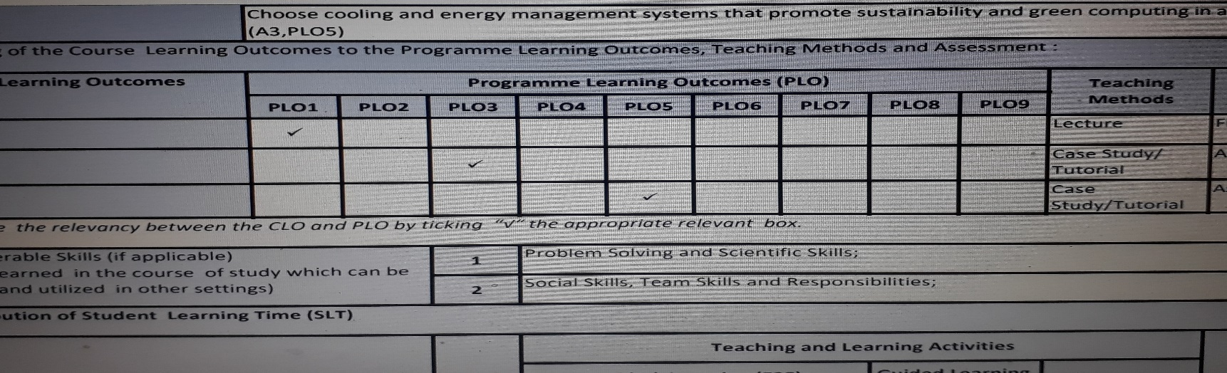
Mapping of CLOs with MOEs Domain
PLO1 – Knowledge
PLO3 – Social Skills and Responsibilities
PLO5 – Communication, Leadership and Team Skills

Slide 7
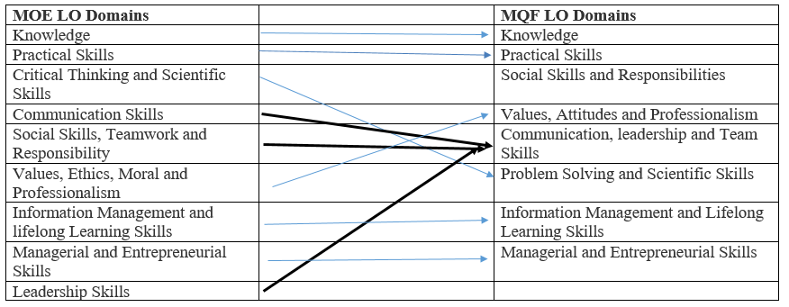
MQF and MOE Domains

Slide 8
Teaching Strategies
Lecture
Tutorial
Case Study (Individual and Group)

Slide 9
Assessment Methods
Final Exam (50%) : CLO1
Group Assignment (50%)
Research : CLO2
WLAN Infrastructure Design : CLO3
**refer to SAIS for details

Slide 10
Student Learning Time (SLT)
Course Credit Value: 3
Total Learning Hours:
Lecture: 24 hours per semester
Tutorial / Case Study : 18 hours per semester
Independent Learning Time: 61 hours

Slide 11
Methods of Delivery
Hence,
We are now moving from the traditional topic based teaching to outcome-based education

Slide 12
Outcomes Based Education (OBE)
OBE is education based on producing particular educational outcomes that:
Focus on what students can actually do after they are taught
Expect all learners / students to successfully achieve particular (sometimes minimum) level of knowledge and abilities.

Slide 13
So…What is OBE?
It’s
NOT
What we want to teach,
It’s
What You should learn

Slide 14
Course Content Outline
CLO1 : Final Exam (50%)
Lecture
Introduction to Data Centre(Week_02_Lecture_Slide)
Site selection and environmental considerations(Week_03_Lecture_Slide)
Architecture Design (Week_04_Lecture_Slide)
Raised Access Floor (Week_05_Lecture_Slide)

Slide 15
Course Content Outline
CLO2 & CLO3 : Group Assignment (50%)
Tutorial / Case Study
IT Hardware
Case Study:Commissioning and Handover
Building Automation and Energy Management Systems
Room Layout
Case Study:Fire Protection and Security Systems
Case Study:Electrical Power Systems
Case Study:Cooling System Options and Environmental Control

Slide 16
What is expected of you
What is expected of you
You should abide to all the rules & regulation of APU
Proper attire
No speaking of dialects
Attendance is compulsory and valid medical certificates or letters from parents /guardians must support any absence from class.
Three lateness will be equal to one absence
All pagers and handphones should be turned off during lectures.

Slide 17
What support is available for you
Consultation hours
Resources
Reference material
Essential Reading:
Lowe,S. D., Davis,D. M. and Green,J.(2017) Building a Modern Data Center: Principles and Strategies of Design.Bluffton:Actual Tech Media. ISBN-13: 978-1943952076.
Lammle, T. and Montgomery, T. (2016) CCNA Data Center - Introducing Cisco Data Center Technologies Study Guide. New York:Wiley.ISBN: 978-1118661093.
Geng, H.(2014) Data Center Handbook.Newyork:Wiley. ISBN: 978-1118436639.
Internet resources

Slide 18
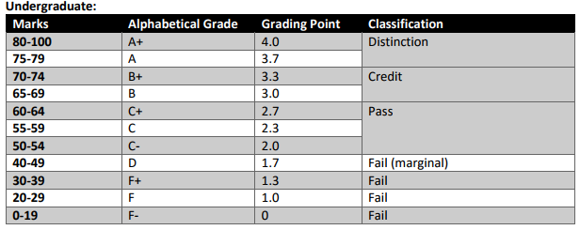
Achievement requirements

Slide 19
Question and answer session
Q & A

Slide 20
What we will cover next
Introduction to the data center

